Slide 1
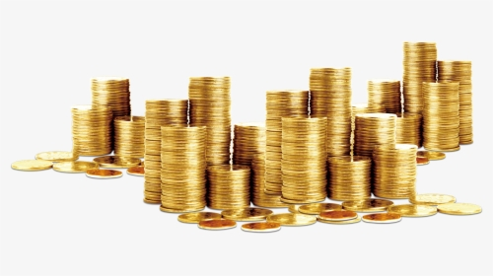
Good morning
Thank you for your attention
Financial Analysis of different States

Slide 2
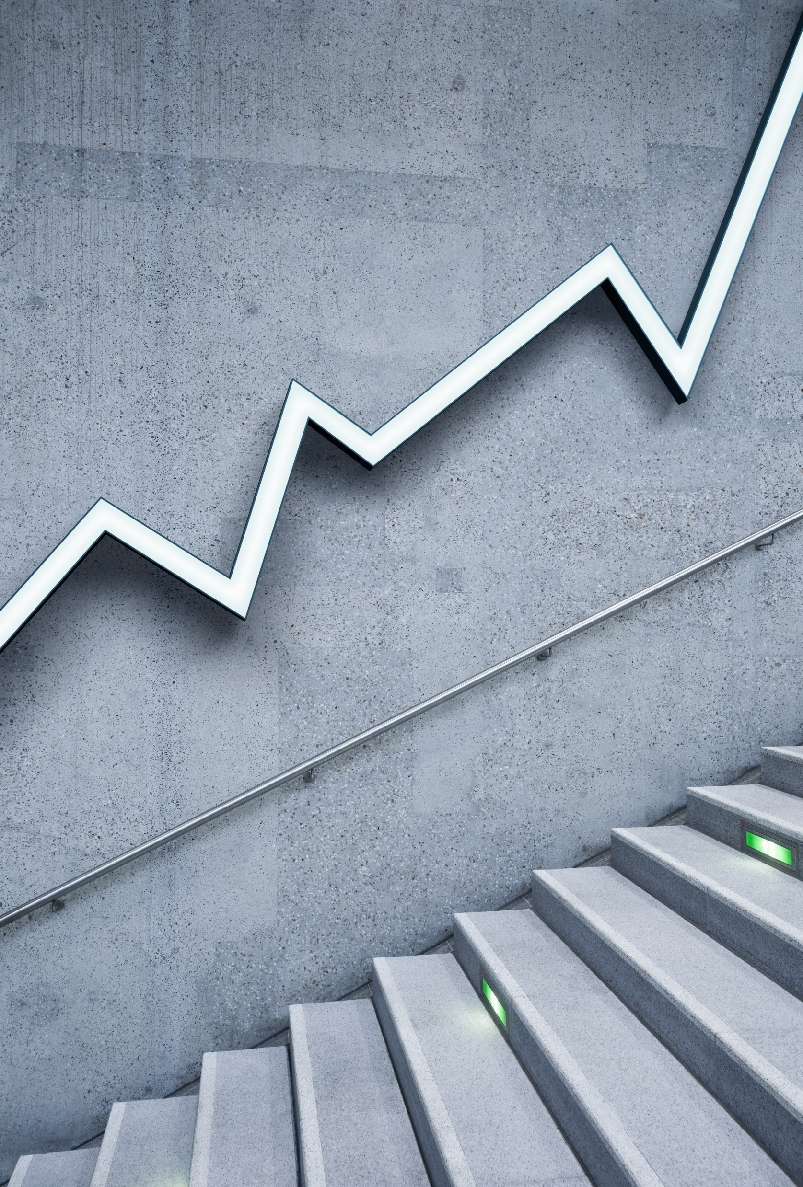
Financial Analysis of different States
Durgesh Kumar
Ajinkya bhangra
Muzzammil Mulla

Slide 3
PRIMARY GOALS
To analyze Annual revenue growth

Slide 4
Maharashtra, Uttar-Pradesh, west Bengal & AP has the highest capital expenditure and GDP followed by the Gujrat in recent year

Slide 5
Correlation between social sector expenditure and tax revenues for different states
The state who are spending more on social sector are getting the maximum revenue
Maharashtra, Gujarat and UP are the top most spender in social service sector.

Slide 6
Top 10 states with highest gross fiscal deficit

Slide 7
Top 2 states which has continuous 40 year downward trend and upward trend as well of Nominal GSDP Series and Gross Fiscal Deficits
Maharashtra and Up both state has highest gross fiscal deficit as nominal GSDP.
Tamilnadu has upper trend in nominal GSDP.
Maharashtra and up has seen significant improvement year on year improvement in nominal GSDP
Tripura and Sikkim has highest gross physical deficit which has seen the downward trend
Sikkim and Mizoram has lowest nominal GSDP.

Slide 8
Sikkim , Nagaland, Mizoram, Manipur, Meghalaya and Tripura has the highest gross deficits

Slide 9
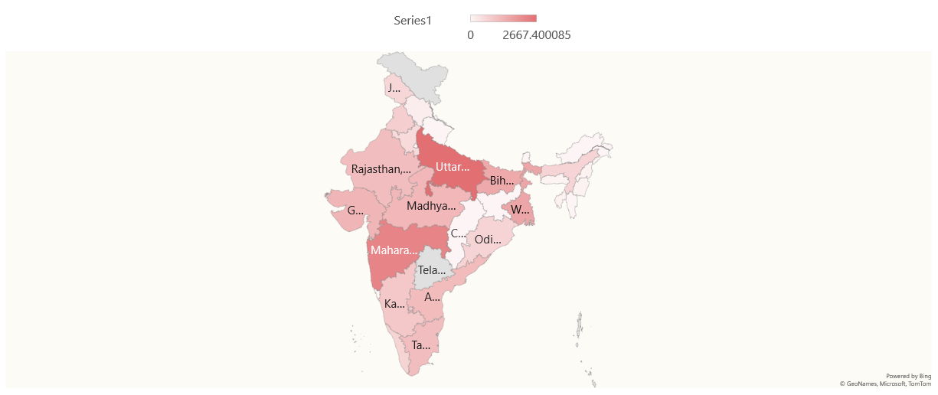
These northeastern state has quite low expenditure on social sector since in order to increase revenue they need to increase social service expenditure

Slide 10
THANK YOU

